Slide 1
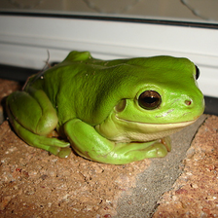



Interpolation
N/M
N
N/M
N

Slide 2
Interpolation
N/M
N
N/M
N

